Slide 1
E-commerce Product Analysis
Team: 112103046 - Shubham Gupta
112103041 - Vedant Dudhale
112103029 - Krishna Chidrawar

Slide 2
Project Overview
Problem Statement - Users find it very difficult to compare the product prices from different E-commerce websites and it generally,consumes a lot of time to extract information about different products from these websites.
Solution - Scraping live information of Products from Amazon and Flipkart Website.
Language - Python
FrontEnd - Streamlit

Slide 3
StakeHolders
Customers : They can use the model to compare the prices of their product from Amazon and Flipkart and thereafter use different data visualisation techniques and our smart recommendation system to further choose the best product at the best price.
Businesspersons : They can use the model to compare the prices of the products from Amazon and Flipkart with the products they are selling at their workspace and furthermore know about the discounts from price comparison graphs these E-commerce websites are providing to their customers.

Slide 4
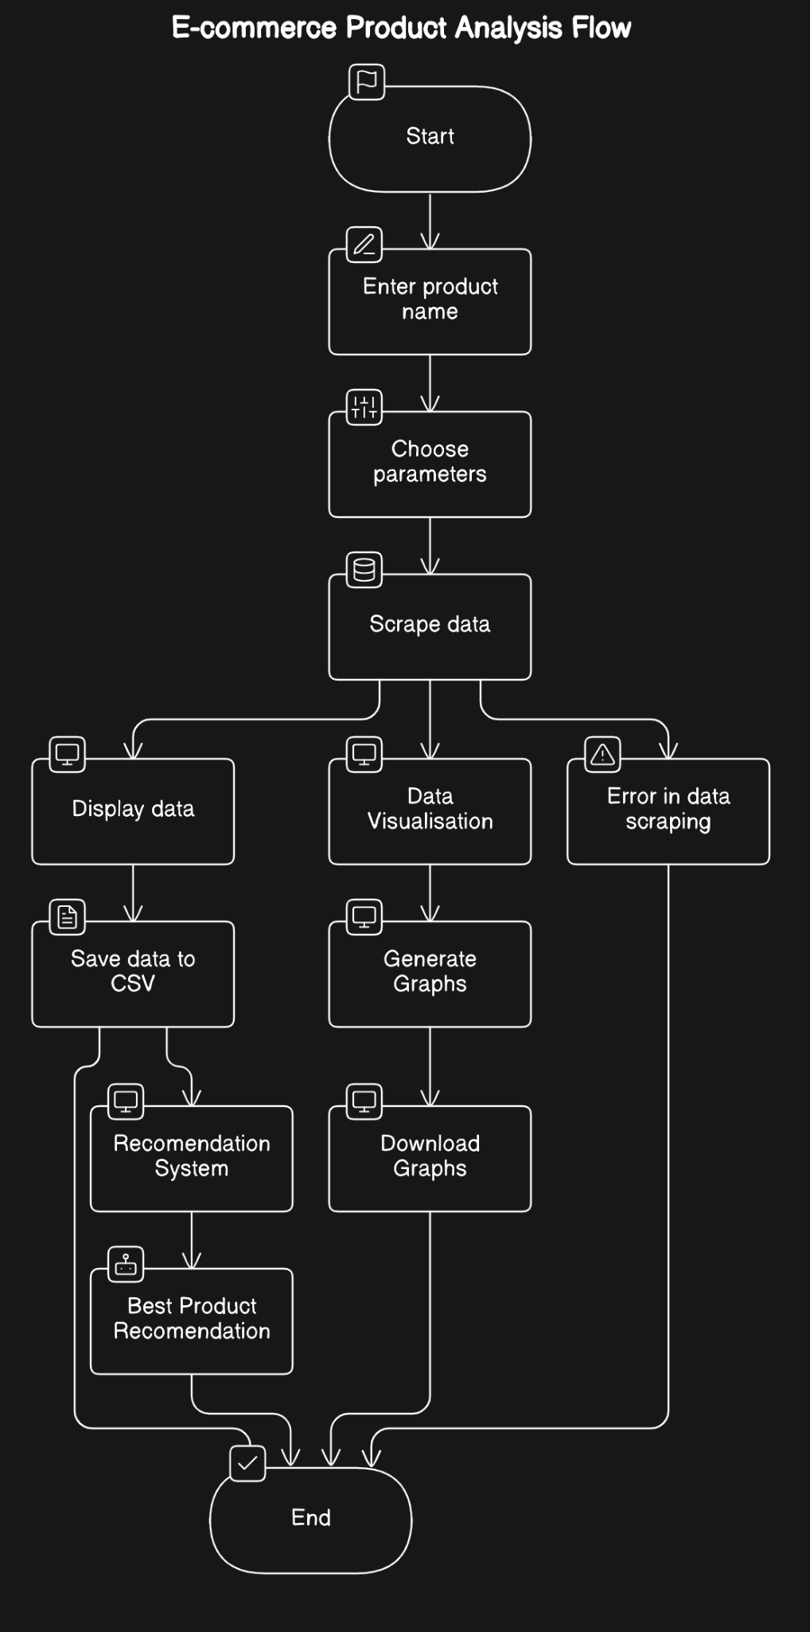

Slide 5
Features
Data Scraping - Scrape live data from E-commerce Websites like Amazon and Flipkart about the product
Data Visualisation - Visualise the data scraped using different graphs like Price Vs M.R.P. and Discount charts.
Data Modeling - Trained Claude API on our dataset and furthermore integrating it with our model to create a smart Recommendation system for Users.

Slide 6
Data Scraping
Libraries Used : UserAgent,BeautifulSoup,Requests and Webdriver. 1)UserAgent & WebDriver - To fake browser visit to the E-Commerce server so that it does not detect automated access. 2)BeautifulSoup - To parse extracted HTML page. 3)Requests - To send HTTPS request in Python.
Scraped Data based on Title,Price,M.R.P and Link Parameters.

Slide 7
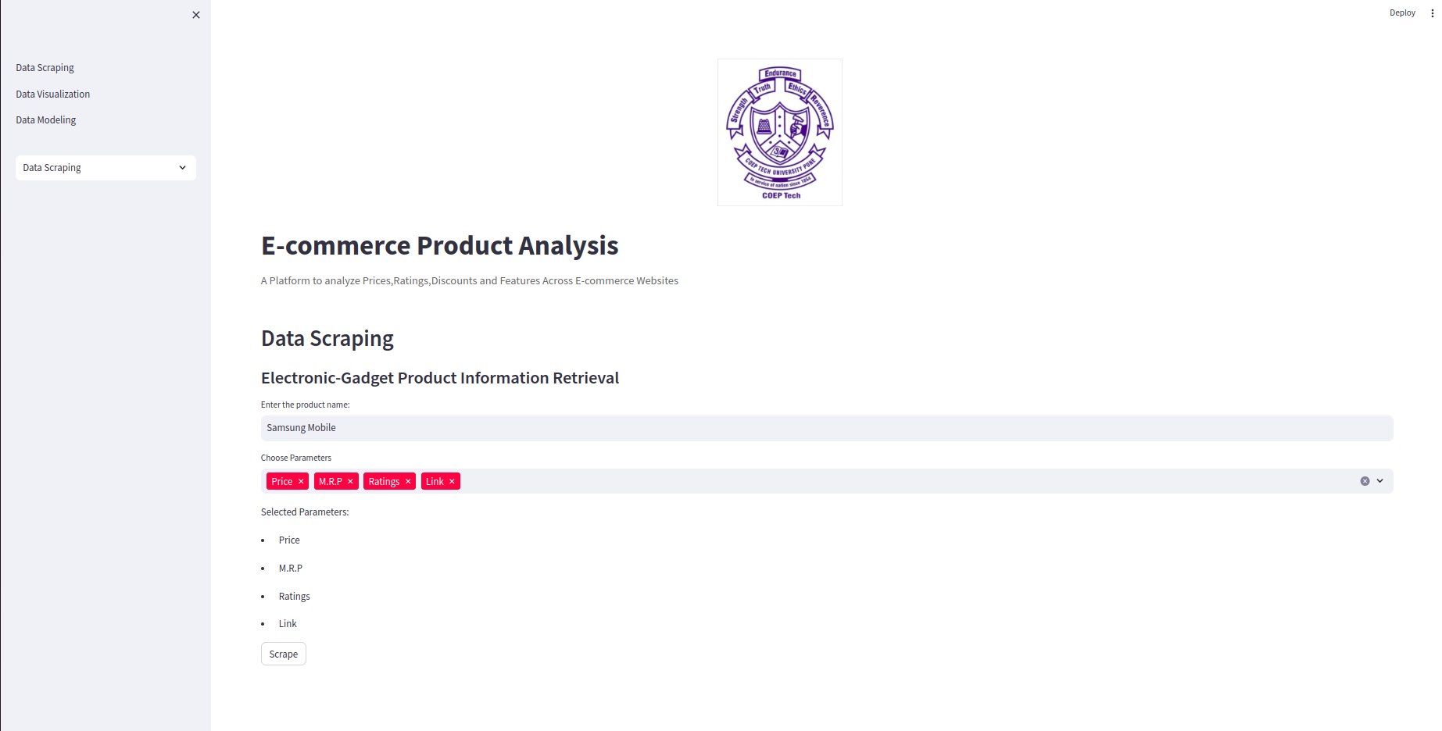
Images of Data Scraping

Slide 8
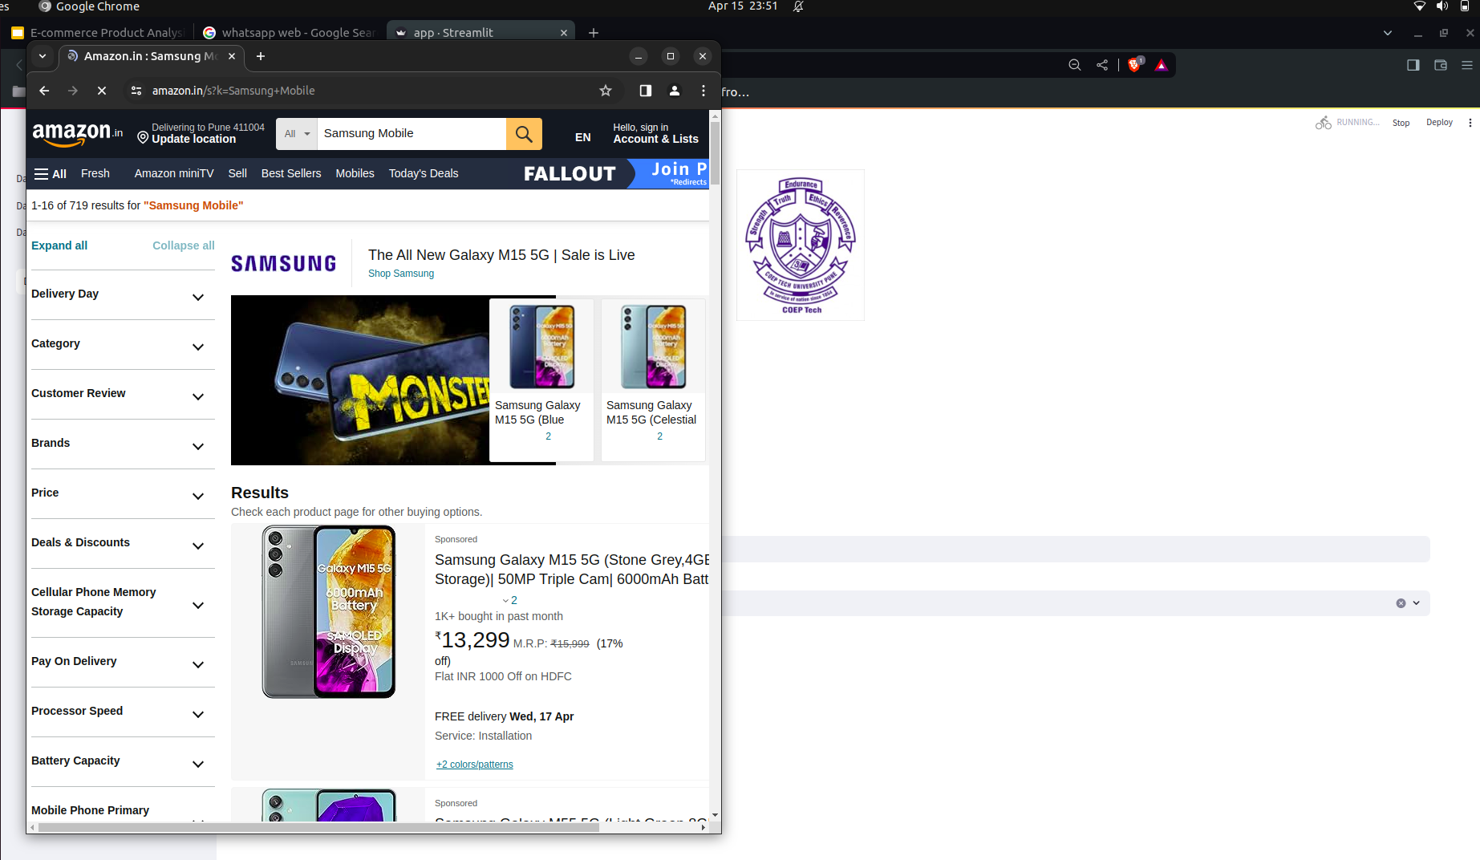
Images of Data Scraping

Slide 9
Data Visualisation
Libraries Used: Pandas,Matplotlib and Seaborn. 1)Pandas - Used to work with datasets generated in data scraping. 2)Matplot & Seaborn - Use to Plot different graphs and to visualize our data.
Dataset from Amazon and Flipkart are been shown along with different graphs like Discounts,Price-Range,etc to get a better view of our dataset.

Slide 10
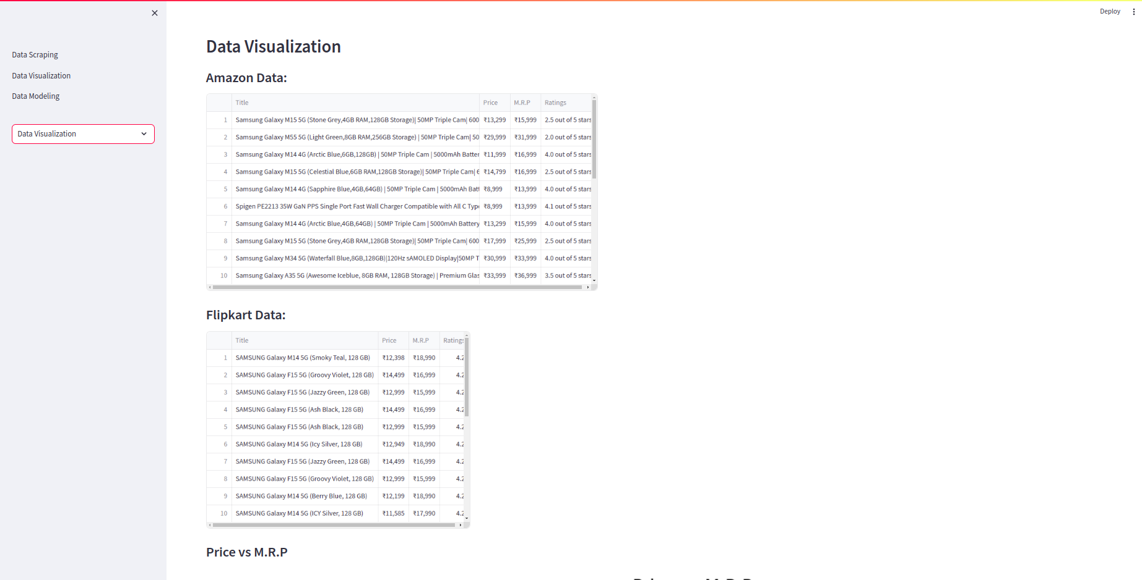
Images of Data Visualisation

Slide 11
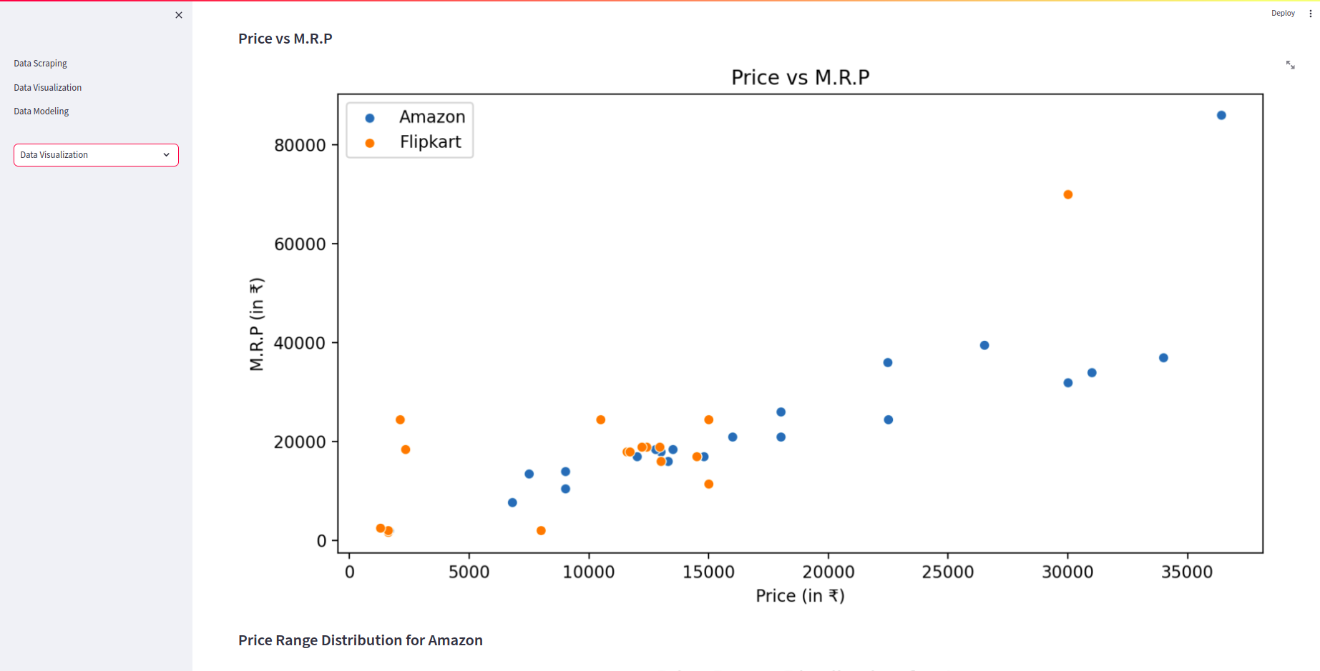
Images of Data Visualisation

Slide 12
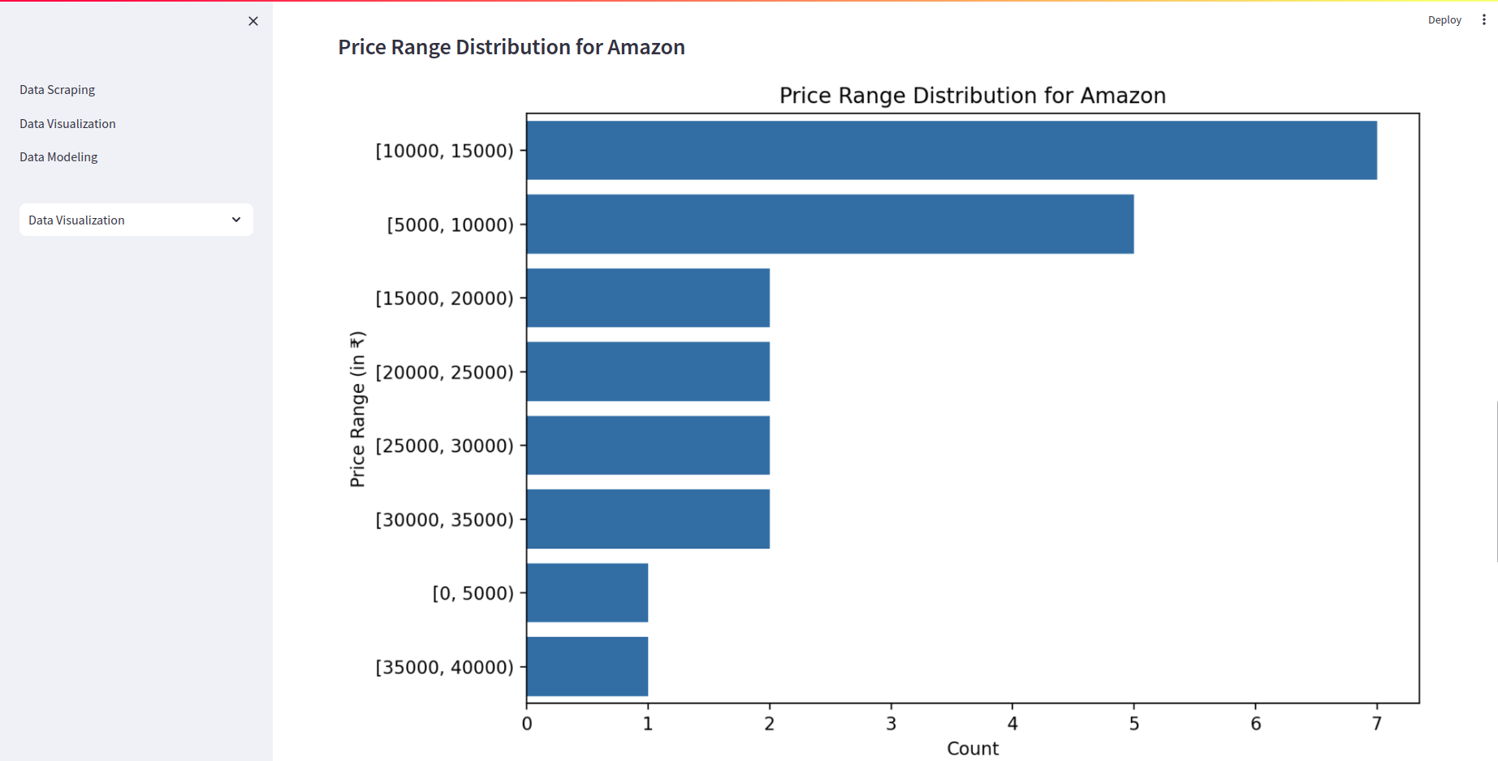
Images of Data Visualisation

Slide 13
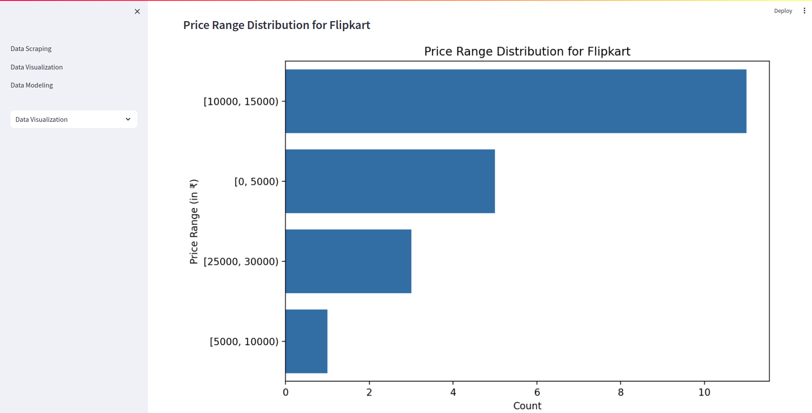
Images of Data Visualisation

Slide 14
Data Modeling
Libraries Used: Anthropic 1)Anthropic - Used to integrate Claude API with our project.
Claude API is trained on the latest data available which gives it edge over other API’s in the market and making it more suitable to use it on our data-scrape model where we scrape live data from website.

Slide 15
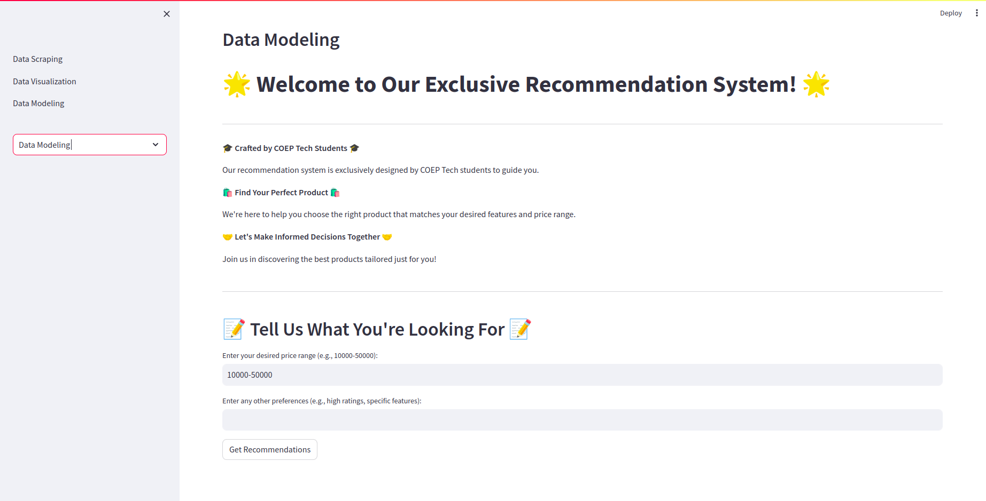
Images of Data Modeling

Slide 16
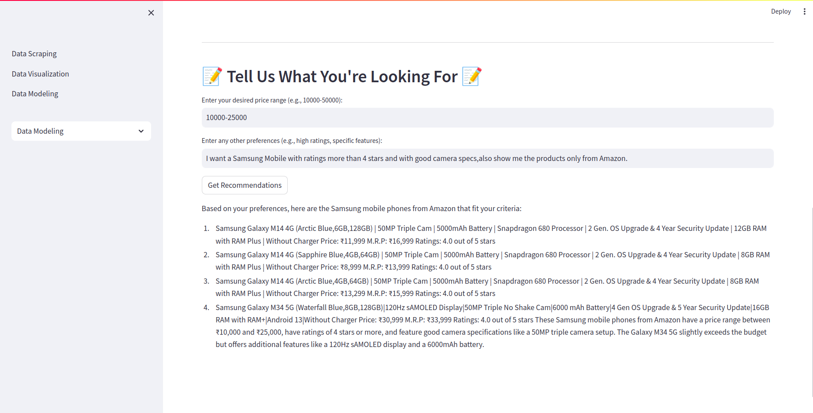
Images of Data Modeling

Slide 17
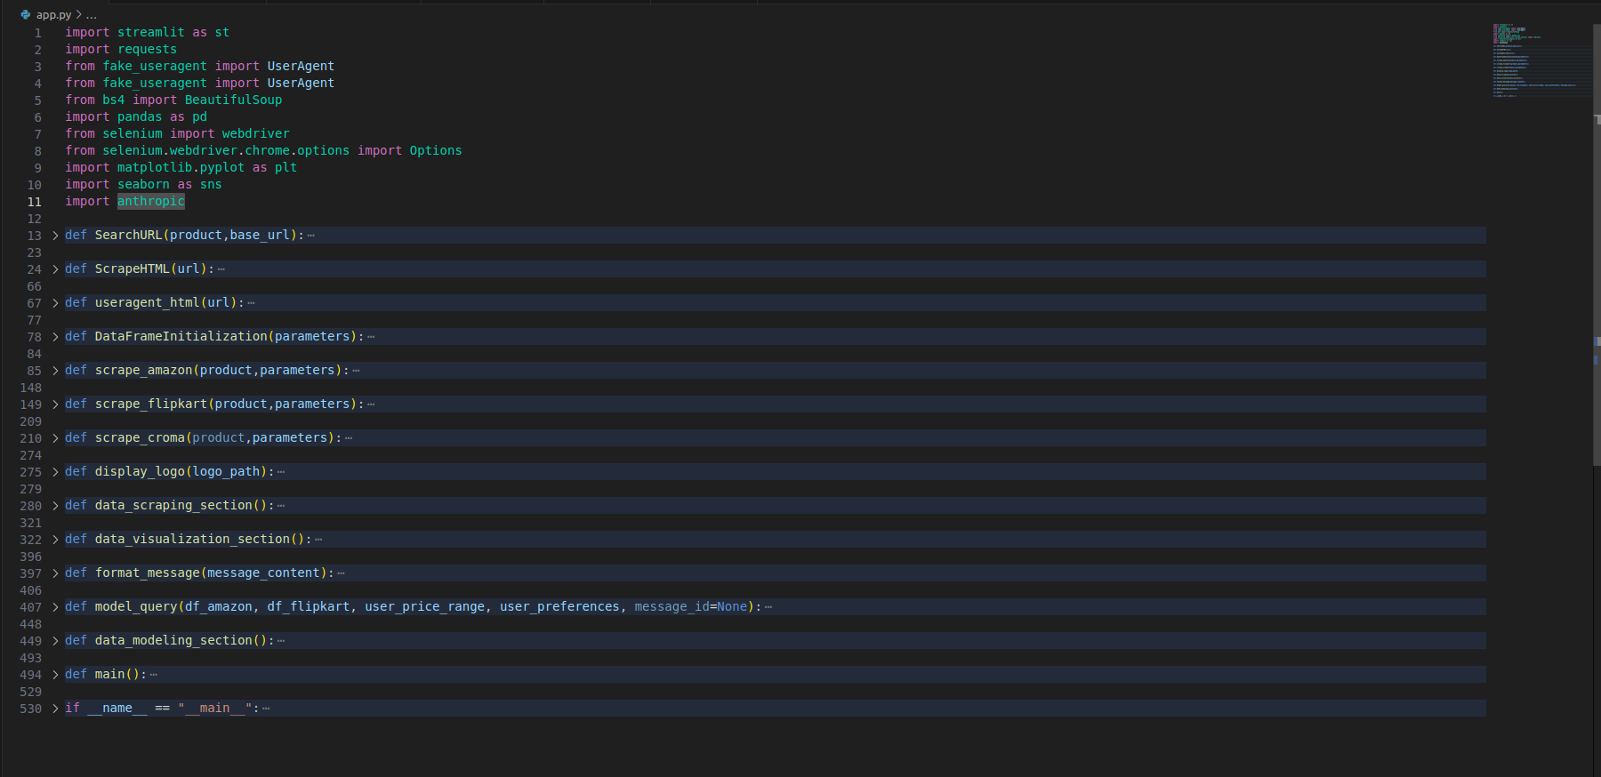
Image of Code Functions

Slide 18
THANK YOU !

